Slide 1
Git Branching Strategies
by Waleed Rizk

Slide 2
Why?
shared codebase
disciplined approach
gating
quality
collaboration
efficiency
accuracy

Slide 3
What?
A “branching strategy” refers to the strategy a software development team employs when:
writing
merging
delivering code
in the context of a version control system like Git.

Slide 4
Development Workflow
Typical:
Features
Ordinary Size/Complexity
No heightened urgency
Frequent so support relevant path

Slide 5
Development Workflow
Non-Typical:
HotFix
BugFix
Large Size/Complexity
Experimental Changes
Heightened urgency
Infrequent so no need to support relevant path

Slide 6
Branch Types
Trunk
Development
Feature
Release
Hotfix

Slide 7
Branching Flows
GitFlow
GitHub Flow
Trunk-based Development (TBD)

Slide 8
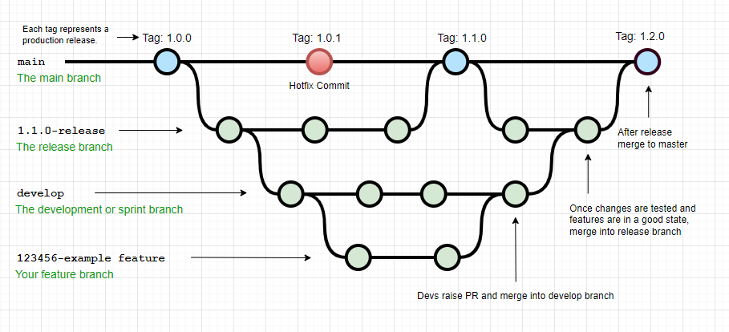
GitFlow

Slide 9
GitFlow
easy and intuitive to organize your work
systematic development process
support multiple versions of production code
can overcomplicate and slow the development and release cycle
long development cycle
can’t support Continuous Delivery or Continuous Integration.

Slide 10
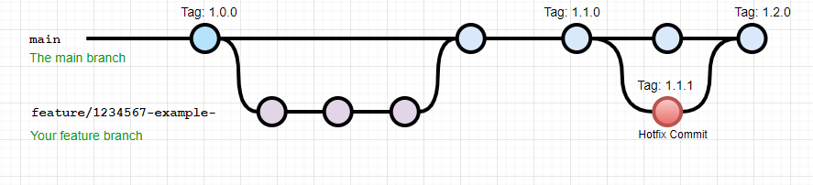
GitHub Flow

Slide 11
GitHub Flow
simplest
allows for Continuous Delivery and Continuous Integration
good for small teams
unable to support multiple simultaneous versions
more prone to production bugs

Slide 12
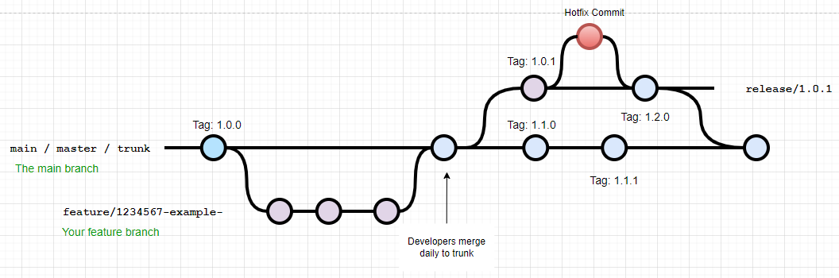
Trunk Based Development

Slide 13
Trunk Based Development
trunk releasable at any point
developers aware of changes regularly
allows for Continuous Delivery and Continuous Integration
good for small teams
unable to support multiple simultaneous versions
more prone to production bugs
feature flags
deployment gating

Slide 14
What is the best Git Branching Strategy?
depends on preference
depends on environment and product
depends on customisation

Slide 15
